Slide 1




NATIONAL FAMILY HEALTH SURVEY- 5
Presentation by Group 7
(PKD campus)

Slide 2

BACKGROUND
Conducted by: Ministry of Health and Family Welfare (MoHFW), Government of India
Implemented by: International Institute for Population Sciences (IIPS), Mumbai
NFHS-1 – 1992–93 – Baseline data on fertility and family planning
NFHS-2 – 1998–99 – Added child health and nutrition data
NFHS-3 – 2005–06 – Included HIV/AIDS and women’s empowerment
NFHS-4 – 2015–16 – Provided district-level data for the first time
NFHS-5 – 2019–21 – Added non-communicable diseases, expanded nutrition indicators

Slide 3

OBJECTIVES
To assess the demographic and health status across states and districts focusing on child health, maternal health, education, sanitation, and nutrition indicators.
To identify regional disparities in basic amenities like electricity, clean water, improved sanitation, cooking fuel, and insurance coverage.
To analyze gender differences in education, reproductive health, early marriage, and usage of family planning methods.
To evaluate childhood health outcomes including vaccination coverage, school attendance, nutrition status, and common childhood illnesses.
To measure adult health risks such as tobacco and alcohol use, anaemia, high blood pressure, diabetes, and cancer screening rates.
To assess the utilization of health services including antenatal care, institutional deliveries, immunization, and financial burden through out-of-pocket expenditure.

Slide 4

DATA UNDERSTANDING & CLEANING
Data understanding - We explored the Health Survey dataset to understand its structure, variables, and key indicators related to health, sanitation, and nutrition. This helped us identify missing values, unusual data points, and patterns across states and districts for accurate analysis in Power BI.
Data Cleaning - We reviewed the dataset in Excel to identify and correct data issues. Decimal points were standardized, star values were replaced with zeros, and negative values were converted to positive where required. The cleaned and formatted data was then imported into Power BI for accurate analysis and visualization.

Slide 5
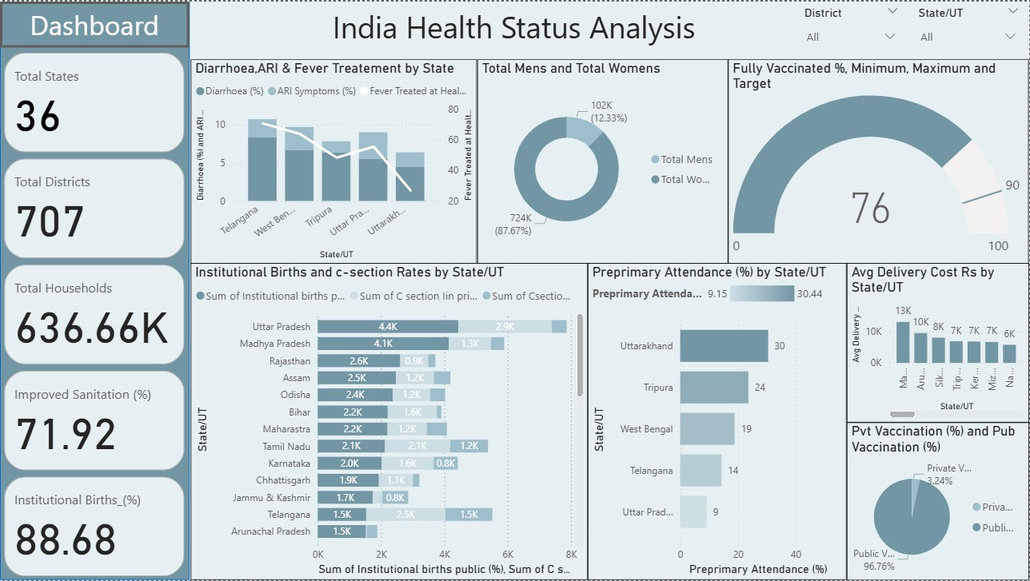
DASHBOARD

Slide 6


KEY INSIGHTS & ANALYTICS
Total of 36 States/UTs and 707 Districts were covered in the analysis.
Survey included 636.66K households, ensuring broad national representation.
Institutional Births: 88.68% — shows strong healthcare support for safe deliveries.
Antenatal Care (ANC): 71.92% — moderate level of check-up coverage during pregnancy.
Improved Sanitation: 71.92% — progress made, but nearly 30% households still lack proper sanitation.
Full Immunization: 76% of children — good performance but still below national target.
Diarrhoea, Fever, and ARI treatment rates differ across states — highlights uneven healthcare access.
C-Section Deliveries: Vary significantly by state — indicates differences in healthcare infrastructure.
Gender Gap: Women’s healthcare access remains lower in certain regions.
Overall Health Status: Improving, but regional and service disparities need focused attention

Slide 7
RECOMMENDATIONS
Increase awareness and accessibility of antenatal care (ANC) services for all pregnant women.
Improve sanitation coverage by focusing on rural and low-income areas.
Strengthen vaccination campaigns to achieve full immunization for all children.
Reduce regional disparities by targeting low-performing states and districts.
Encourage institutional deliveries through incentives and better healthcare facilities.
Enhance treatment availability for childhood illnesses like diarrhoea, fever, and ARI.
Monitor and regulate C-section deliveries to ensure they are medically necessary.
Promote women’s health awareness and access to healthcare services.
Support data-based planning and policy decisions using health dashboards and surveys.
Continue public health education programs to sustain long-term health improvements.

Slide 8
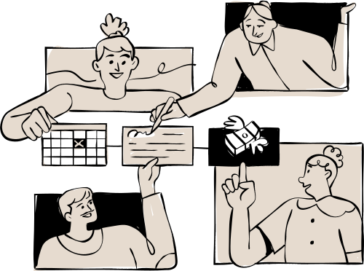
CONCLUSION
The study shows that India’s health situation is improving, with safer hospital births, better vaccination rates and cleaner sanitation, but some areas still need more care, especially for pregnant women and rural families. By improving health services and spreading awareness, India can make sure everyone gets better and equal healthcare.

Slide 9

THANK YOU

